Slide 1
Software Engineering
Lecture #22
Fakhar Lodhi

Slide 2
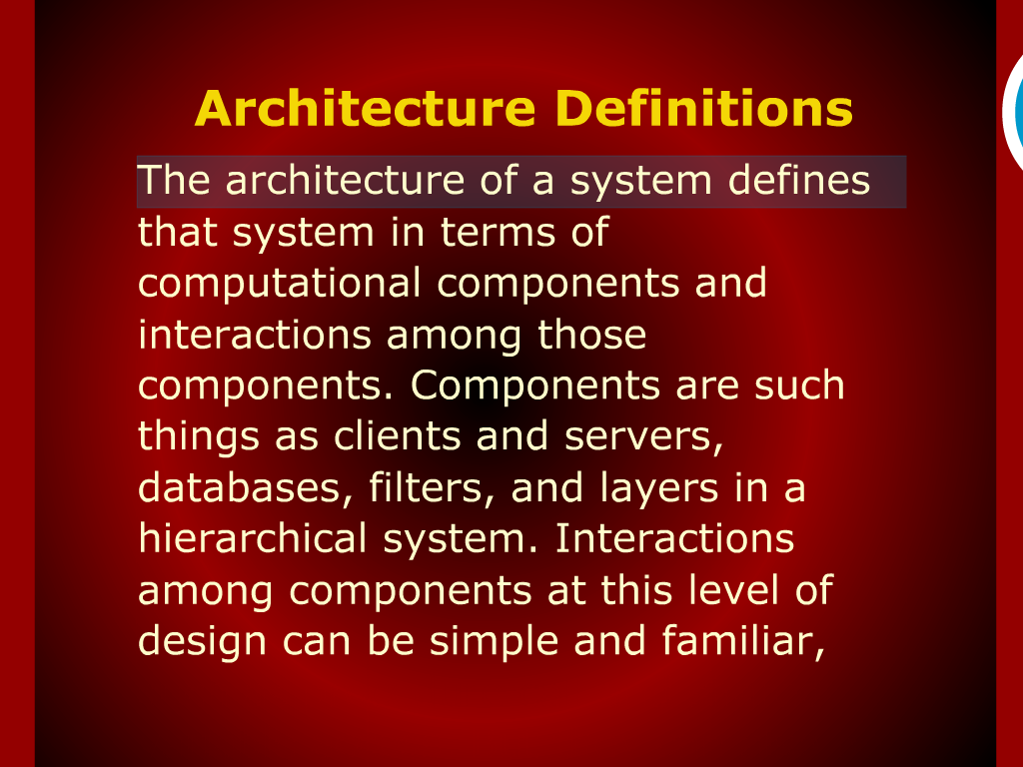
Architecture Definitions

Slide 3
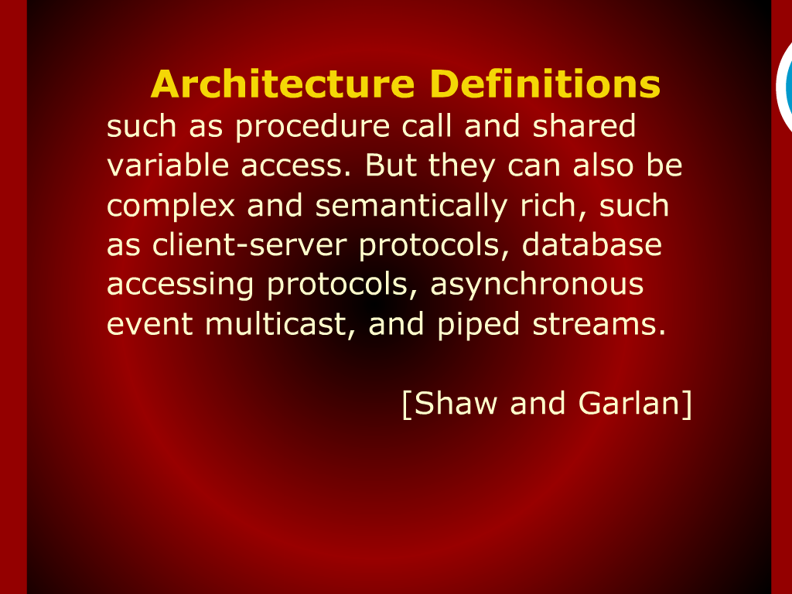
Architecture Definitions

Slide 4
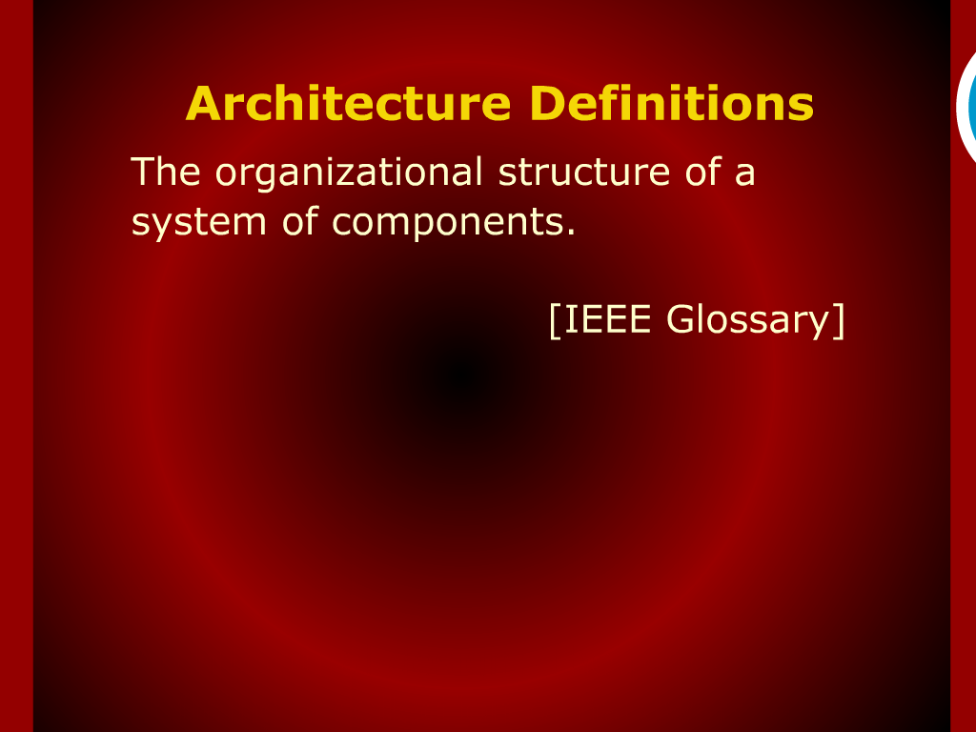
Architecture Definitions

Slide 5
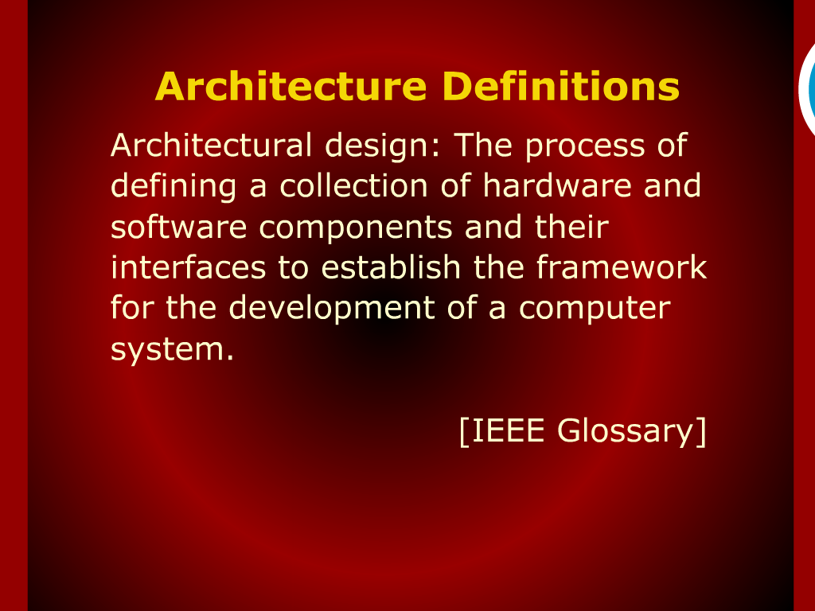
Architecture Definitions

Slide 6
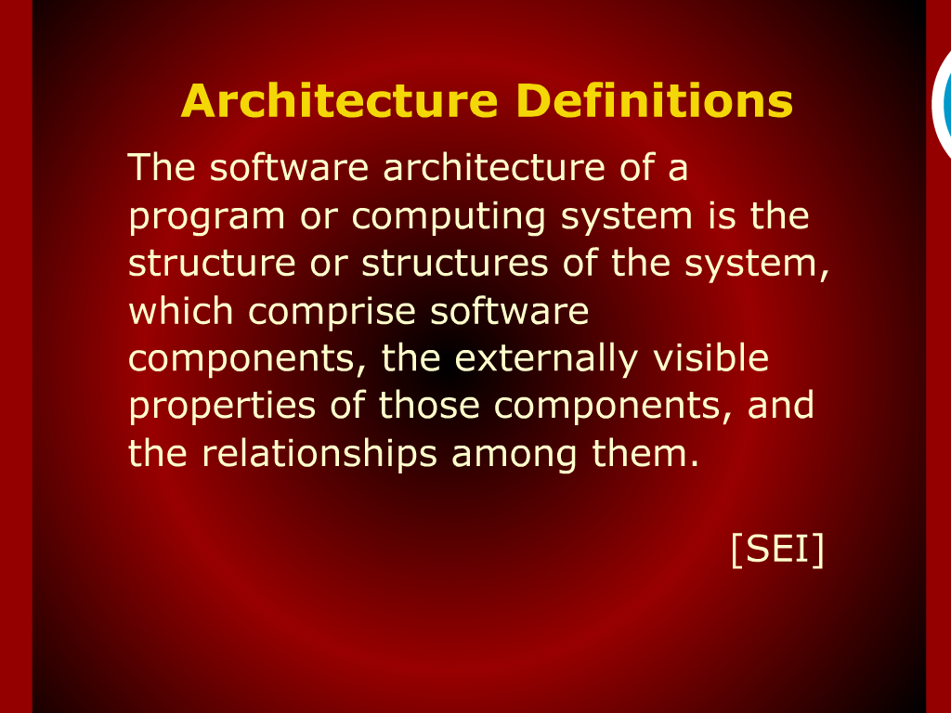
Architecture Definition

Slide 7
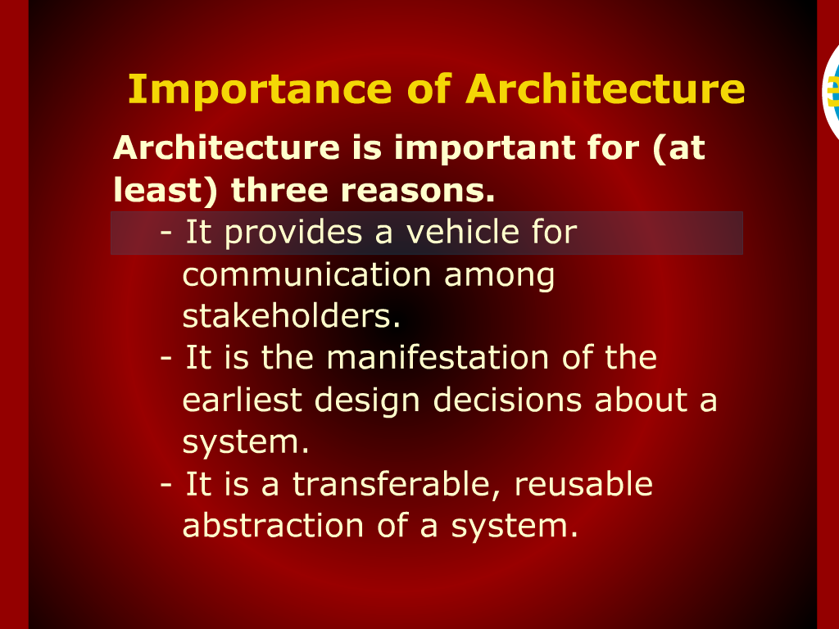
Importance of Architectural

Slide 8
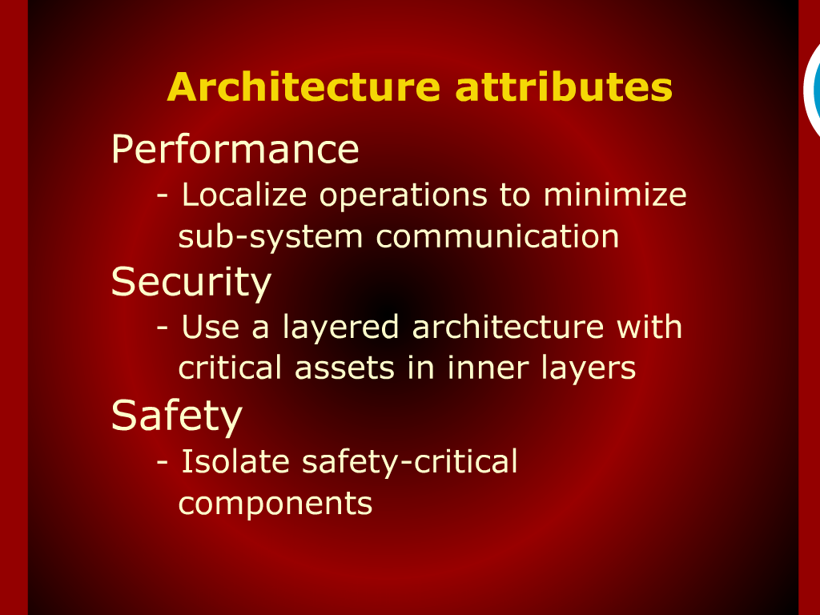
Architectural attributes

Slide 9
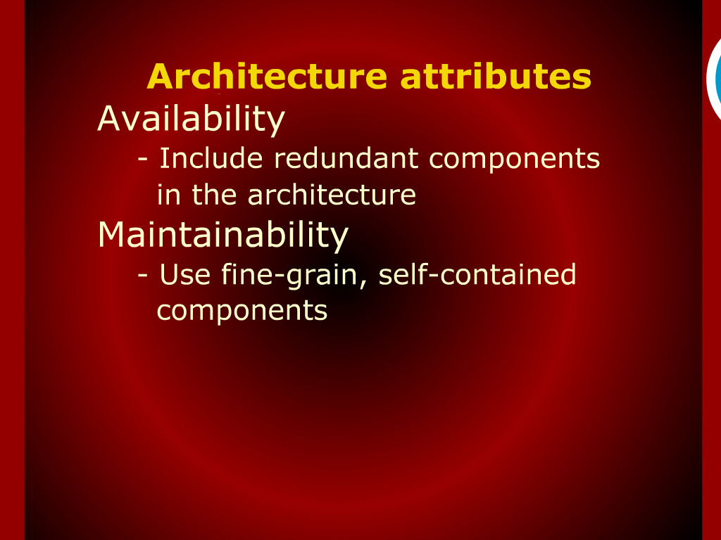
Architectural design process

Slide 10
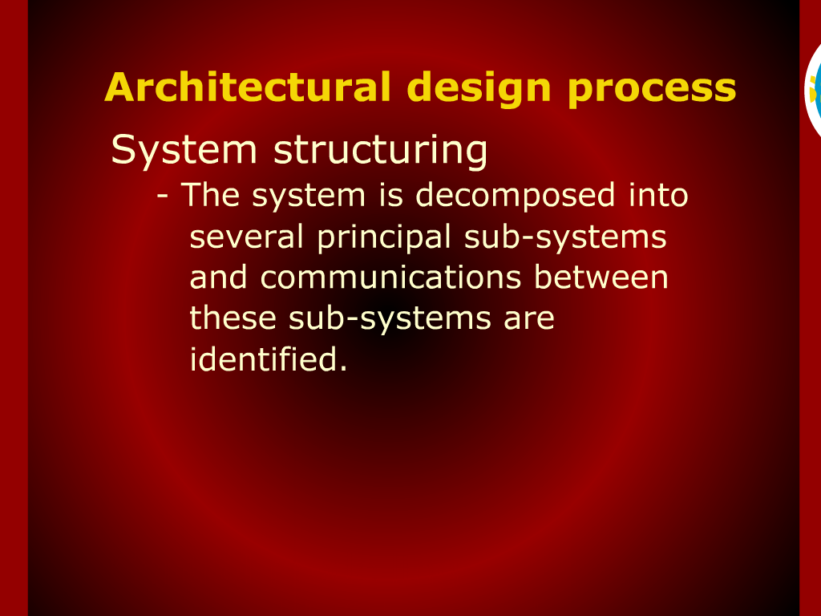
Architectural design process

Slide 11
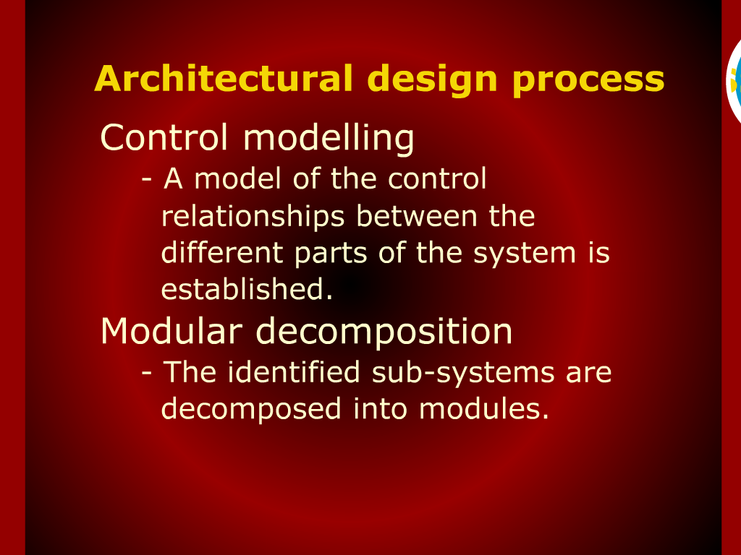
Architectural design process

Slide 12
Importance of Software Architecture

Slide 13
Recap

Slide 14
Architectural Attributes

Slide 15
Architectural Design Process

Slide 16
Summary of Today’s Lecture

